Slide 1
03 | Operationalize end-to-end Cloud Analytics Solutions
Ryan Mich | Senior Consultant
Venks Mantha | Data Solution Architect, NY Metro
Gaurav Malhotra | Sr. Program Manager, Data Factory
Ed Hagan | Consultant

Slide 2

About Ryan: Day 2429
Senior Consultant
Known for “traditional” data warehousing
(Dimensional Modeling, SQL, ETL, APS, SSAS, SSIS, SSRS, SQL DW…)
Now I do a bunch of Azure stuff.
70-534, 70-473, 70-475
MCSA, MCSE, MCPS
DECLARE
@StartDate date = '2011-04-18',
@Today date = '2017-12-11'
SELECT
DATEDIFF(year, @StartDate, @Today) as Years,
DATEDIFF(month, @StartDate, @Today) as Months,
DATEDIFF(day, @StartDate, @Today) as [Days]
Years Months Days
----------- ----------- -----------
6 80 2429
(1 row(s) affected)

Slide 3
Setting Expectations
Target Audience
Any “data” person with some technical background
Preparation
Reading & Doing
Yes, some Memorization is required

Slide 4
Setting Expectations Continued …
Key Takeaways
Focused information to help you prepare for the exam
Module where almost all the content is tied to one service – Azure Data Factory
Hands-on is a MUST for this module

Slide 5
In this module
Data Factory Overview & Concepts
Data Factory Operations
Data Factory Monitoring & Management
Data Factory Extensions
Data Factory – Roadmap

Slide 6
In this module
Data Factory Overview & Concepts
Data Factory Operations
Data Factory Monitoring & Management
Data Factory Extensions
Data Factory – Roadmap

Slide 7
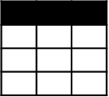
Traditional Analytics Platforms
Extract
Transform
Load
EDW
(SQL Svr, Teradata, etc)
OLTP
…
ETL Tool
(SSIS, etc)
Transformed Data
BI Tools
Original Data
ERP
LOB
Data Marts
Data Lake(s)
Dashboards
Apps

Slide 8
Evolving Approaches to Analytics
Extract
Transform
Load
EDW
(SQL Svr, Teradata, etc)
OLTP
…
ETL Tool
(SSIS, etc)
Transformed Data
BI Tools
Original Data
ERP
LOB
Data Marts
Data Lake(s)
Dashboards
Social
Ingest (EL)
Apps
Devices
Scale-out Storage & Compute
(HDFS, Blob Storage, etc)
Sensors
Original Data
Web
Streaming data
Transform & Load

Slide 9
Evolving Approaches to Analytics
Extract
Transform
Load
EDW
(SQL Svr, Teradata, etc)
OLTP
…
ETL Tool
(SSIS, etc)
Transformed Data
BI Tools
Original Data
ERP
LOB
Data Marts
Data Lake(s)
Dashboards
Social
Ingest (EL)
Apps
Devices
Scale-out Storage & Compute
(HDFS, Blob Storage, etc)
Sensors
Original Data
Web
Streaming data
Transform & Load

Slide 10
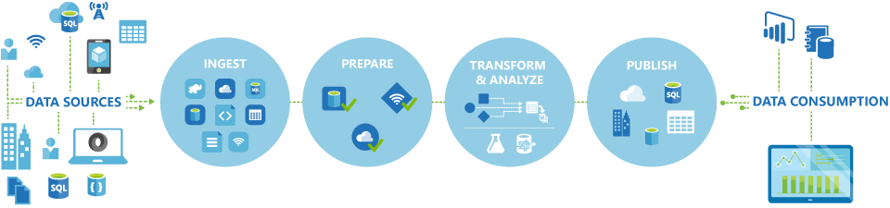
Azure Data Factory
A managed cloud service for building & operating data pipelines
Command & Control
Not Compute and Store
Part of the Cortana Intelligence Suite

Slide 11
Azure Data Factory
OPERATIONALIZE BATCH PIPELINES
Orchestrate | Schedule | Monitor | Manage
CONTINUOUS ITERATIONS →

Slide 12







Cortana Analytics Suite Transform data into intelligent action
Information Management
Big Data Stores
Machine Learning and Analytics
Dashboards and Visualizations
Business apps
Power BI
Azure
Data Factory
Azure
Machine Learning
Personal Digital Assistant
Azure
Data Lake store
Cortana
Azure Data Lake analytics service
People
Custom apps
Azure
Data Catalog
Perceptual Intelligence
Azure HDInsight
(Hadoop and Spark)
Face, vision
Azure
SQL Data Warehouse
Speech, text
Azure
Event Hub
Azure
Stream Analytics
Business Scenarios
Sensors and devices
Recommendations,
customer churn,
forecasting, etc.
Automated Systems
DATA
INTELLIGENCE
ACTION
Notes:
Cortana Analytics Suite delivers an end-to-end platform with integrated and comprehensive set of tools and services to help you build intelligent applications that let you easily take advantage of Advanced Analytics.
First Cortana Analytics Suite provides services to bring data in, so that you can analyze it. It provides information management capabilities like Azure Data Factory so that you can pull data from any source (relational DB like SQL or non-relational ones like your Hadoop cluster) in an automated and scheduled way, while performing the necessary data transforms (like setting certain data colums as dates vs. currency etc). Think ETL (Extract, Transform, Load) in the cloud. Event hub does the same for IoT type ingestion of data that streams in from lots of end points.
The data brought in then can be persisted in flexible big data storage services like Data Lake and Azure SQL DW.
You can then use a wide range of analytics services from Azure ML to Azure HDInsight to Azure Stream Analytics to analyze the data that are stored in the big data storage. This means you can create analytics services and models specific to your business need (say real time demand forecasting).
The resultant analytics services and models created by taking these steps can then be surfaced as interactive dashboards and visualizations via Power BI
These same analytics services and models created can also be integrated into various different UI (web apps or mobile apps or rich client apps) as well as via integrations with Cortana, so end users can naturally interact with them via speech etc., and so that end users can get proactively be notified by Cortana if the analytics model finds a new anomaly (unusual growth in certain product purchases- in the case of real time demand forecasting example given above) or whatever deserves the attention of the business users.

Slide 13
Why Data Factory?
Orchestrate, schedule, monitor & manage data pipelines
Compose data processing, storage, and movement services (on-premises and cloud)
Operate on a recurring schedule
Automatic cloud resource management
Globally available data movement capability
Intelligent job-based resource management
Single pane of glass
One place to manage and monitor data pipelines

Slide 14
Data Factory Concepts

Slide 15
Data Factory Concepts
Linked services
Data management gateway
Data store
Compute
Datasets
Pipelines
Activities
Time slice
Run

Slide 16
Linked Services
Pointer to compute and storage services
Data store linked services
Azure Storage
Azure CosmosDB
Azure Data Lake Store
Azure SQL DB/DW
On-premises file system
On-premises HDFS
Compute linked services
HDInsight
Azure Data Lake Analytics
Azure ML

Slide 17
Datasets
Logical pointer to data stored in data store linked service
Examples:
Azure Blob storage
Azure Data Lake store
Azure table
Azure SQL DB/DW table
Azure CosmosDB collection
SQL Server table (on-premises/IaaS)

Slide 18
Pipelines
A Logical grouping of Activities
To perform a task (copy activity, transformation activity)
Active only between Start Time and End Time
Activities in the pipeline are the ones that get executed (not pipeline itself, logical)
An Activity is the “unit” of Orchestration in Data Factory
An Action to perform on data
Zero or more data sets as input producing one or more output data sets.
Structure
Anatomy of a pipeline
Activities section of a pipeline
Policies

Slide 19
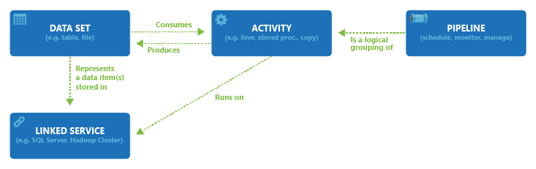
Data Sources, Linked Services & Datasets

Slide 20
Activities

Slide 21
Pipelines

Slide 22
Data Sets
A Pointer to the data to be processed
Data Set
Definition
Type
Structure
Availability
Policy
External & Scoped Datasets
Notes:
Please read and understand the data set link

Slide 23
Data Set Structure
{
"name": "<name of dataset>",
"properties": {
"type": "<type of dataset: AzureBlob, AzureSql etc...>",
"external": <boolean flag to indicate external data. only for input datasets>,
"linkedServiceName": "<Name of the linked service that refers to a data store.>",
"structure": [
{
"name": "<Name of the column>",
"type": "<Name of the type>"
}
],
"typeProperties": {
"<type specific property>": "<value>",
"<type specific property 2>": "<value 2>",
},
"availability": {
"frequency":
"<Specifies the time unit for data slice production. Supported frequency: Minute, Hour, Day, Week, Month>",
"interval":
"<Specifies the interval within the defined frequency.
For example, frequency set to 'Hour' and interval set to 1 indicates that new data slices should be produced hourly>"
},
"policy":
{
}
}
}

Slide 24
Data Set Structure - Example
Data Set
Linked Service
{
"name": "DatasetSample",
"properties": {
"type": "AzureSqlTable",
"linkedServiceName": "AzureSqlLinkedService",
"typeProperties":
{
"tableName": "MyTable"
},
"availability":
{
"frequency": "Day",
"interval": 1
}
}
}
{
"name": "AzureSqlLinkedService",
"properties": {
"type": "AzureSqlDatabase",
"description": "",
"typeProperties": {
"connectionString": "Data Source=tcp:<servername>.database.windows.net,1433;Initial Catalog=<databasename>;User ID=<username>@<servername>;Password=<password>;Integrated Security=False;Encrypt=True;Connect Timeout=30"
}
}
}

Slide 25
Activity Types
Data Movement Activities
Moves data between supported data stores
Data Transformation Activities
Process data using computes

Slide 26
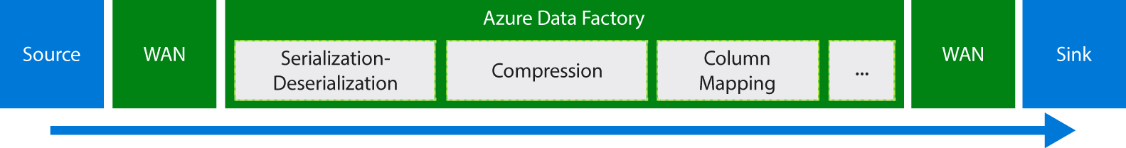
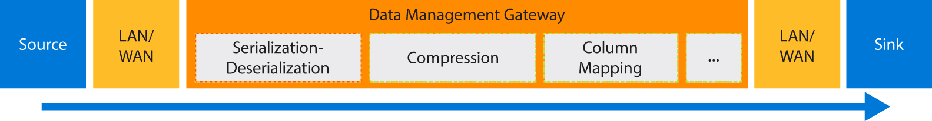
Data Migration
Cloud to Cloud
On-premise to Cloud

Slide 27
Data Movement - Supported Data Stores and Formats
Category | Data store | Supported as a Source | Supported as a Sink
Azure | Azure Blob storage Azure Cosmos DB Azure Data Lake Store Azure SQL Database Azure SQL Data Warehouse Azure Search Index Azure Table storage | ✓ ✓ ✓ ✓ ✓ ✓ | ✓ ✓ ✓ ✓ ✓ ✓ ✓
Databases | Amazon Redshift DB2* MySQL* Oracle* PostgreSQL* SAP Business Warehouse* SAP HANA* SQL Server* Sybase* Teradata* | ✓ ✓ ✓ ✓ ✓ ✓ ✓ ✓ ✓ ✓ | ✓ ✓
NoSQL | Cassandra* MongoDB* | ✓ ✓
Category | Data store | Supported as a Source | Supported as a Sink
File | Amazon S3 File System* FTP HDFS* SFTP | ✓ ✓ ✓ ✓ ✓ | ✓
Others | Generic HTTP Generic OData Generic ODBC* Salesforce Web Table (table from HTML) GE Historian* | ✓ ✓ ✓ ✓ ✓ ✓
* Can be on-premises or on Azure IaaS, and require you to install Data Management Gateway on an on-premises/Azure IaaS machine.
https://docs.microsoft.com/en-us/azure/data-factory/v1/data-factory-data-movement-activities#supported-data-stores-and-formats

Slide 28
Data Transformation - Supported Activity Types
Data transformation activity | Compute environment
Hive | HDInsight [Hadoop]
Pig | HDInsight [Hadoop]
MapReduce | HDInsight [Hadoop]
Hadoop Streaming | HDInsight [Hadoop]
Spark | HDInsight [Hadoop]
Machine Learning activities: Batch Execution and Update Resource | Azure VM
Stored Procedure | Azure SQL, Azure SQL Data Warehouse, or SQL Server
Data Lake Analytics U-SQL | Azure Data Lake Analytics
DotNet | HDInsight [Hadoop] or Azure Batch
Two Types of Compute Environment:
On-Demand - Fully managed by data factory
Bring Your Own - Managed by you but registered as linked service

Slide 29
In this module
Data Factory Concepts
Data Factory Operations
Data Factory Monitoring & Management
Data Factory Extensions
Data Factory – Roadmap

Slide 30
Creating and Operating a Data Factory

Slide 31
Options to Create a Data Factory
Azure Portal
Author and deploy (JSON editor)
Copy data wizard
PowerShell
.NET
REST API
Visual Studio Data Factory Plugin

Slide 32

Creating a Data Factory
Create Data Factory
Create Linked Services
Set up Data Management Gateway if needed
Create Datasets
Create Pipelines with Activities

Slide 33
Scheduling a Pipeline
Dataset Availability property
Frequency
Interval
Pipeline Scheduler property
Frequency
Interval
Pipeline Start and End property
Sets window of time for pipeline to run

Slide 34
Scheduling & Execution
Data slice: A unit of data consumed and produced by an activity run
Time series datasets and data slices
Continuous sequence of data points (E.g. sensor data and telemetry data)
Data factory can process time series data in batches

Slide 35
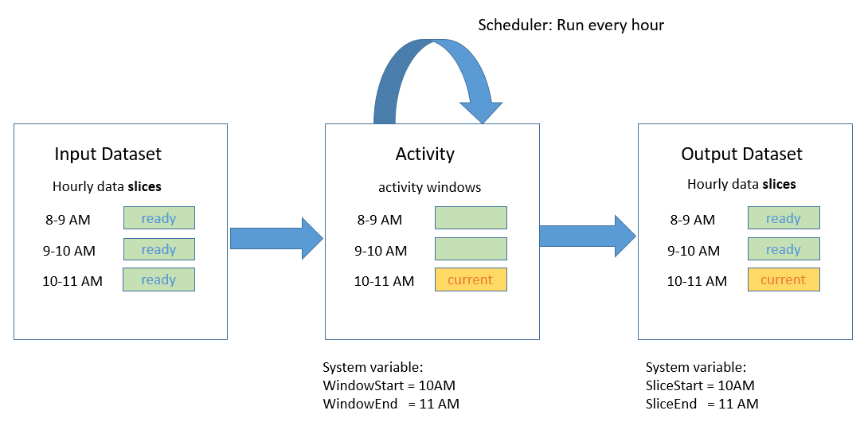
Scheduling & Execution
Example:
"scheduler": {
"frequency": "Hour",
"interval": 1
}
Creates a Series of Tumbling Windows (Activity Windows)
Fixed-size series, non-overlapping and contiguous

Slide 36
Scheduling & Execution
Pipeline has an Active Period defined by Start and End Times
Pipeline Start time can be set to be in the Past
Allows data factory to calculate and back fill data slices
Processing starts immediately
Backfilled data slices can be run in parallel by using the “Concurrency” Property
Running Activities in a Sequence
Chaining
Second Activity runs ONLY when first activity is finished

Slide 37
Scheduling & Execution
Datasets with Different Frequencies
Expressions
Data Factory Functions
Data Slice Validation
Downstream activity will not execute if prior activity is NOT validated
External Data
Data NOT produced by data factory. Set External Property to TRUE
Onetime Pipeline
Set PipelineMode to “OneTime”

Slide 38
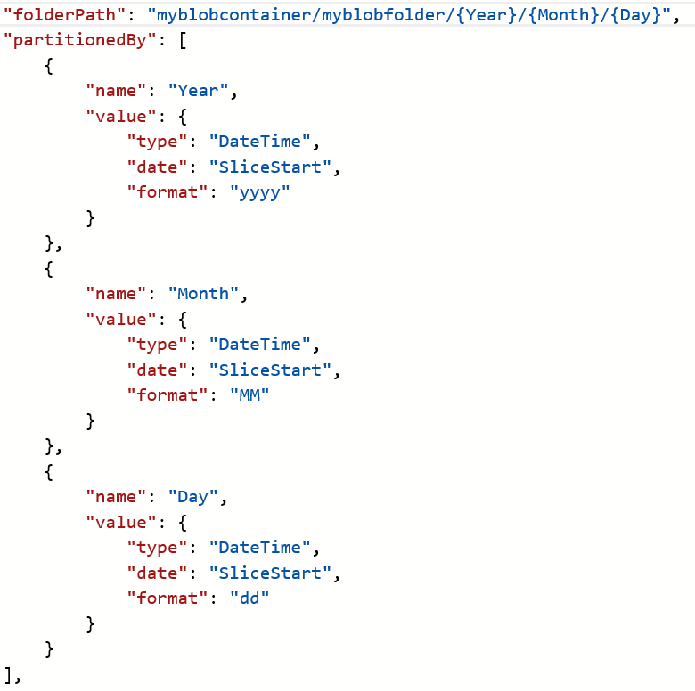
Partitioning Strategy
Can set dynamic partitions based on time series data

Slide 39
In this module
Data Factory Concepts
Data Factory Operations
Data Factory Monitoring & Management
Data Factory Extensions
Data Factory – Roadmap

Slide 40
Data Factory Diagram
Single pane of glass to view end-to-end pipeline
Immediately spot failed slice
Can drill down to see error
Rerun failed slice in Azure Portal or using PowerShell

Slide 41
Alerts
Set up thresholds
When activity counter hits threshold, send email to Azure Subscription administrator

Slide 42
Monitoring & Management
Show My Latest Executions, What Failed, What’s Running right now?
Can I Debug, Re-run my failures?
Can I perform Batch actions (bulk pause, resume pipelines etc.)?
Can I raise Alerts on various events (failures etc.)?
Can I configure my monitoring layouts?

Slide 43
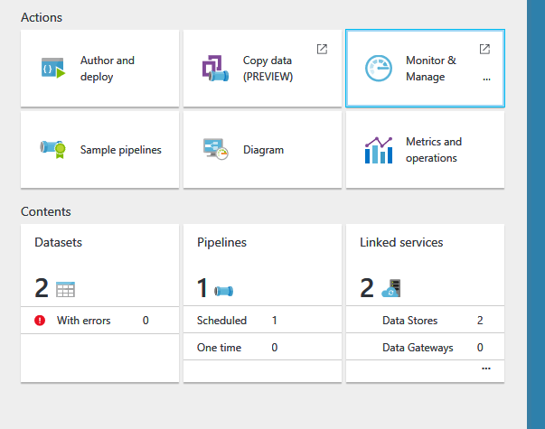

Monitoring & Management

Slide 44
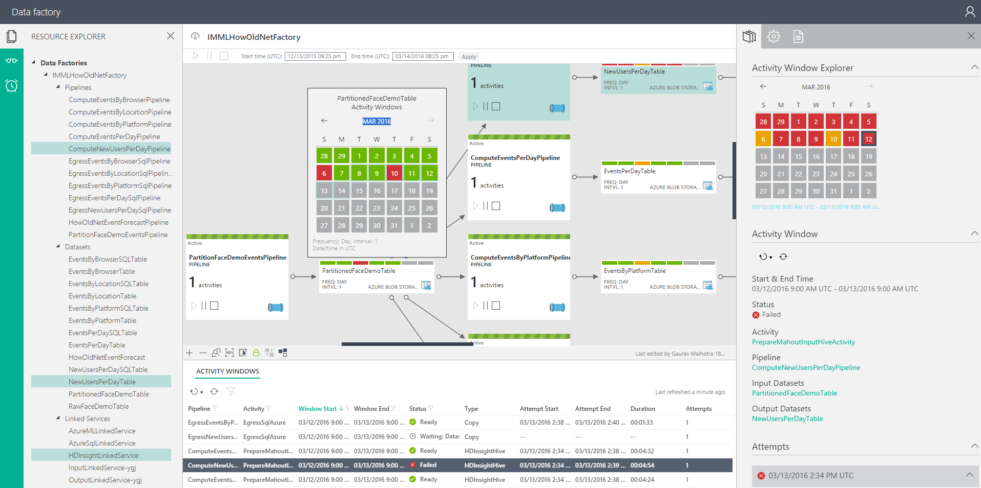
Monitoring & Management App

Slide 45
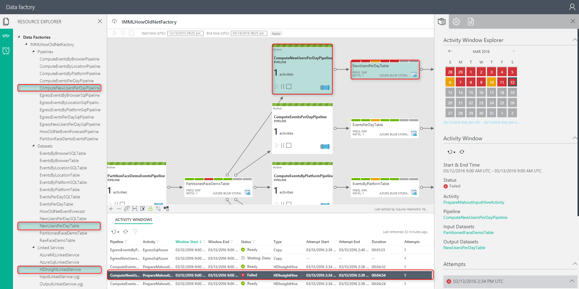
Monitoring & Management App Dense Information with Context

Slide 46
In this module
Data Factory Concepts
Data Factory Operations
Data Factory Monitoring & Management
Data Factory Extensions
Data Factory – Roadmap

Slide 47
Data Factory Extensions - Developer Reference
Method | Resource Location | References
Azure portal | https://portal.azure.com/
Azure PowerShell | Download the latest Azure PowerShell | Cmdlet reference
.NET Class Library | The Azure Data Factory .NET SDK enables you to create, monitor, and manage Azure data factories and extend Data Factory using a .NET activity. See Use custom activities in an Azure Data Factory pipeline and Create, monitor, and manage Azure data factories using Data Factory .NET SDK articles to help you get started. Downloading the latest Nuget You can download the latest Azure Data Factory Management Library Nuget package from: https://www.nuget.org/packages/Microsoft.Azure.Management.DataFactories/ Using Package Manager Console in Visual Studio You can run the following command in Visual Studio’s Package Manager Console to get the latest Azure Data Factory Management Library Install-Package Microsoft.Azure.Management.DataFactories | .NET SDK Reference
REST API | You can use the Data Factory REST API to create, monitor, and manage Azure data factories. | REST API Reference

Slide 48
Data Factory Extensions – Custom Activity
Move data to/from a data store NOT supported by Data Factory
Transform/Process data NOT supported by Data Factory
A .NET Custom Activity with appropriate Logic
Use this activity in a pipeline
Azure Batch Service or HDInsight Cluster is needed to run the custom .NET Activity

Slide 49
Data Factory Extensions – Custom Activity Steps
Create a Custom Activity
Using Visual Studio, create a .NET Class Library Project
Zip all the binary files and upload to Azure Blob Storage
Create an Azure Data Factory
Create Linked Services
Create Input and Output Datasets
Create and Run the Pipeline

Slide 50
In this module
Data Factory Concepts
Data Factory Operations
Data Factory Monitoring & Management
Data Factory Extensions
Data Factory – Roadmap

Slide 51
Data Factory Roadmap
 | Current | Roadmap
Authoring | Web-based editor Visual Studio plug-in (intellisense & pipeline templates) VS 2015 | Drag & Drop authoring Application templates (CAS: customer churn, recommendations, etc.)
Data Movement | Azure storage, Azure Document Db, on-premises: SQL Server, Oracle DB, File Shares, MySQL, Teradata, Azure Document Db, PostgreSQL, DB2, Sybase, Azure SQL DW, Cassandra, MongoDB, Generic ODBC, Generic OData, Salesforce, GE Historian | New Data sources added each month. 40 new connectors in next 3-6 months Public preview: Azure Data Lake Store
Data Production | Azure Machine Learning integration HDInsight enhancements Azure Batch | Additional Activities (Spark etc.) Limited Preview: Azure Data Lake Analytics, HDInsight on Linux Improvements: Data Types, Reference Data
Data Management | Monitoring diagram: lineage views, custom layout “Recently updated datasets” view “Drill down into pipelines” | New M&M App: easy navigation & debugability, system views, filtering, sorting, etc. Enhanced alerting
App Model | Time Series Log Processing | Control Flow (Events, Triggers, Loops)
Geo Location | Note: can orchestrate/schedule/monitor resources in all geo-regions now Globally deployed data movement | Additional geo-regions

Slide 52
Resources
Azure Data Factory
ADF Video 1 https://mva.microsoft.com/en-US/training-courses/orchestrating-data-and-services-with-azure-data-factory-15962
ADF Video 2 https://azure.microsoft.com/en-us/documentation/videos/how-to-monitor--manage-big-data-pipelines-with-azure-data-factory/
Introduction https://azure.microsoft.com/en-us/documentation/articles/data-factory-introduction/
Tutorial 1 https://azure.microsoft.com/en-us/documentation/articles/data-factory-build-your-first-pipeline/
Azure Portal, Visual Studio, Power Shell, ARM Template, REST API
Data Sources https://azure.microsoft.com/en-us/documentation/articles/data-factory-data-movement-activities/
Activity Types https://azure.microsoft.com/en-us/documentation/articles/data-factory-data-transformation-activities/
Data Sets https://azure.microsoft.com/en-us/documentation/articles/data-factory-create-datasets/
Pipelines https://azure.microsoft.com/en-us/documentation/articles/data-factory-create-pipelines/
Schedule/Exec https://azure.microsoft.com/en-us/documentation/articles/data-factory-scheduling-and-execution/
Tutorial 2 https://azure.microsoft.com/en-us/documentation/articles/data-factory-copy-data-from-azure-blob-storage-to-sql-database/
Azure Portal, Visual Studio, Power Shell, REST API, .NET API, Copy Wizard
Tutorial 3 https://azure.microsoft.com/en-us/documentation/articles/data-factory-move-data-between-onprem-and-cloud/
Samples https://azure.microsoft.com/en-us/documentation/articles/data-factory-samples/

Slide 53
Resources Continued …
Learning Path
https://azure.microsoft.com/en-us/documentation/learning-paths/data-factory/
Azure Data Factory Monitor and Manage
https://azure.microsoft.com/en-us/documentation/articles/data-factory-monitor-manage-app/
End-2-End Data Processing Overview
https://blogs.msdn.microsoft.com/data_insights_global_practice/2015/10/23/end-to-end-data-processing-using-azure-data-factory-overview/
Design and Implement Big Data & Analytics Solutions
https://mva.microsoft.com/en-US/training-courses/design-and-implement-big-data-advanced-analytics-solutions-16531?l=bsSKczWdC_7706218965

Slide 54

Q&A

Slide 55
Copy Blob to SQL DB Steps
https://portal.azure.com
Make sure you are Logged-in
Must have a valid subscription
Create the Blob Storage
Create the SQL DB
SQL Server Management Studio or
Visual Studio

Slide 56
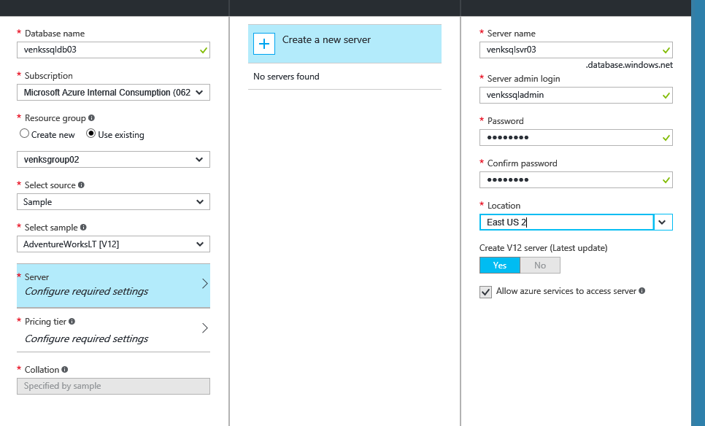
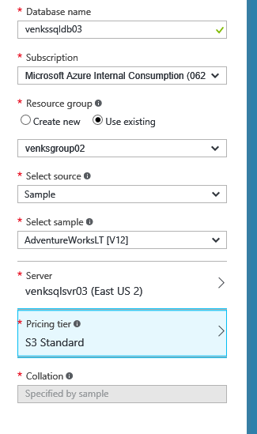
Azure SQL DB Creation

Slide 57
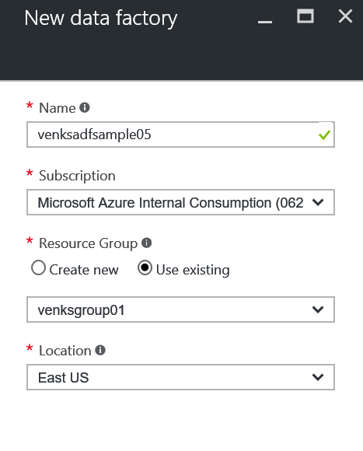
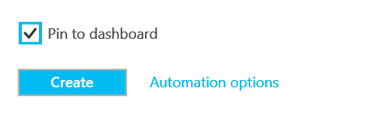
Azure Data Factory - Creation

Slide 58
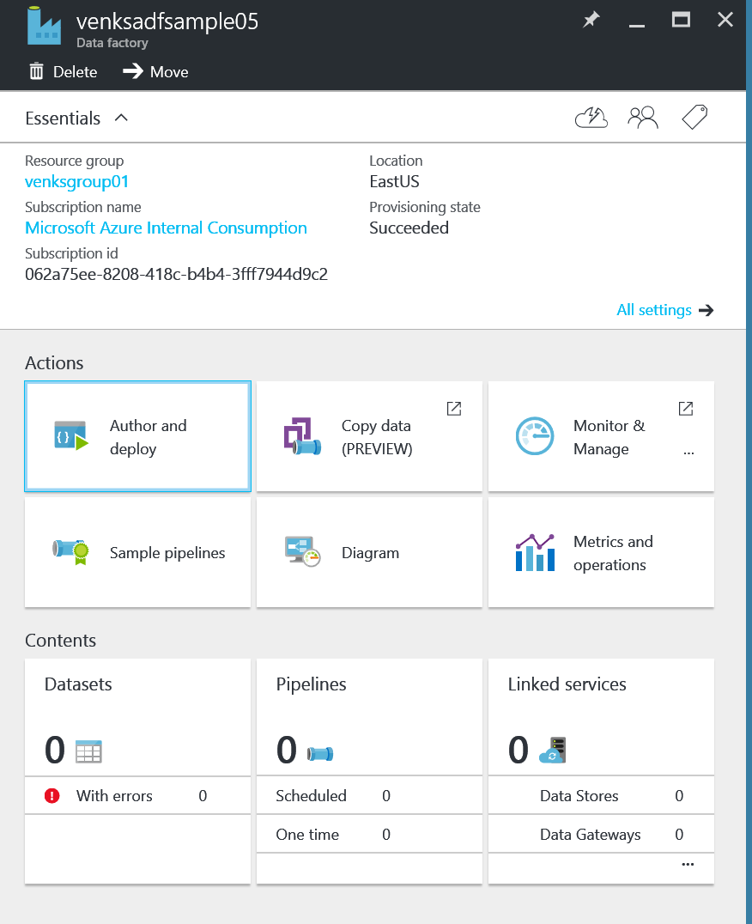
Azure Data Factory – Main Blade

